Slide 1
Mobile Development Simplified with Xamarin
James Montemagno
Program Manager, Mobile Dev Tools
@JamesMontemagno

Slide 2







.NET: Your platform for building anything
Desktop
Web
Cloud
Mobile
Gaming
IoT
AI
.NET

Slide 3

What is Xamarin?

Slide 4
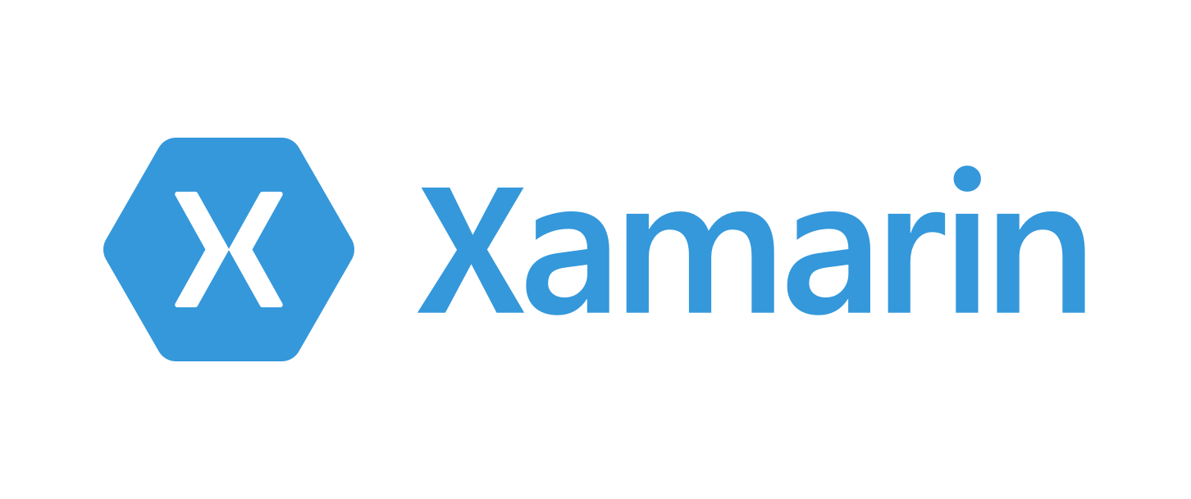
An open source app platform
from Microsoft for
building modern & performant
iOS, Android, macOS,
watchOS, & tvOS apps with .NET.

Slide 5
App Development With Xamarin

Slide 6




Productive environment
Maximize code reuse
Native performance & integrations
Expansive ecosystem

Slide 7

Xamarin App Architecture
.NET
C#
C#
C#
Shared C#
Business Logic • Platform APIs • User Interface
Shared C# codebase • 100% native API access • High performance

Slide 8












Native API Access

Slide 9

Xamarin.Essentials
Secure Settings
Sms
Preferences
Flashlight
Clipboard
Gyroscope
Magnetometer
Geolocation
Phone Dialer
Device Display Info
Email
Device Info
Battery
Compass
Accelerometer
Screen Lock
Data Transfer
Text to Speech
Geocoding
File System
Connectivity
Vibration
aka.ms/xamarinessentials

Slide 10
Xamarin.Essentials: Cross-Platform Native APIs
.NET
C#
C#
C#
Xamarin.Essentials
Shared C#
Business Logic • User Interface

Slide 11

Xamarin.Forms

Slide 12
An open source mobile UI framework
from Microsoft for building
iOS, Android, & Windows apps with .NET
from a single shared codebase.

Slide 13
Xamarin.Forms: Cross-Platform Native UI
.NET
C#
C#
C#
Xamarin.Forms - UI
Xamarin.Essentials
Shared C#
Business Logic

Slide 14
Demo
James Montemagno

Slide 15




























Xamarin
Loved by developers, trusted by enterprise

Slide 16
Recap
Native iOS, Android, watchOS, tvOS, and macOS apps in C# & Visual Studio 2019 & Visual Studio 2019 for Mac with Xamarin
Share .NET Business Logic with Any App
Works with all your favorite libraries (JSON.NET, Refit, Polly, etc.)
Shared Native APIs with Xamarin.Essentials
Shared Native UI with Xamarin.Forms
Compatible with Latest Visual Studio Features
Live Share
IntelliCode
Previewers
iOS Remote Simulator

Slide 17
Get Started Today visualstudio.com/xamarin

Slide 18


Weekly development podcast
mergeconflict.fm
Thank you.
aka.ms/xamarin
aka.ms/xamarinessentials
github.com/jamesmontemagno/VS2019-FirstXamarinApp
Weekly development show
xamarinshow.com
James
Montemagno
Principal Program Manager – Mobile Developer Tools, Microsoft
motz@microsoft.com
Montemagno.com
@JamesMontemagno

